Slide 1


Presented by Habiba Alaa Eldin
ADVENTURE
WORKS
BI End-to-End

Slide 2

TABLE OF CONTENTS
1
Project Overview
2
Data Integration
3
Data Analysis and Visualization
4
Conclusion

Slide 3

PROJECT OVERVIEW
Adventure Works Cycles is a multinational company for bikes manufacturing, the company continues to grow.
They demand an End-To-End Business Intelligence Solution to track and analyze their sales for a better decision-making.

Slide 4


PROJECT PHASES
Data Integration
Data Analysis and Visualization
Tools Used:
SSIS & VS
Tools Used:
Power BI

Slide 5

DATA INTEGRATION

Slide 6
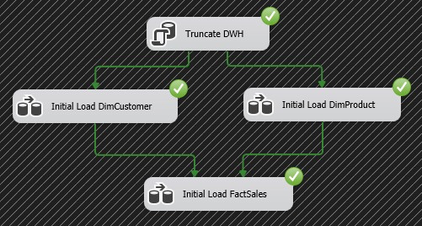
CONTROL FLOW

Slide 7
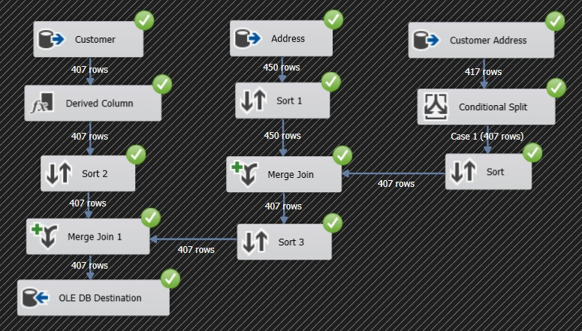
DIMCUSTOMERS

Slide 8
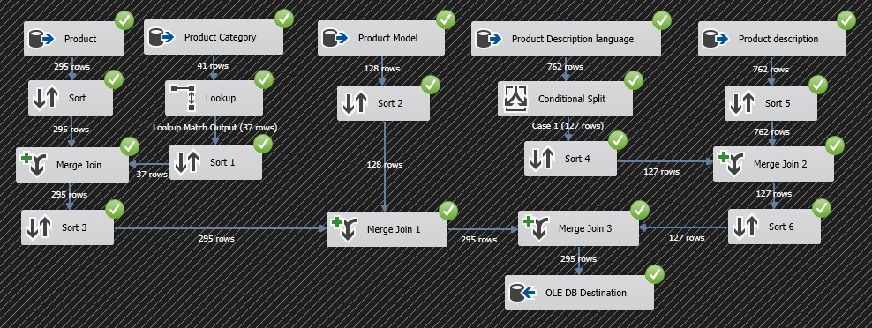
DIMPRODUCT

Slide 9
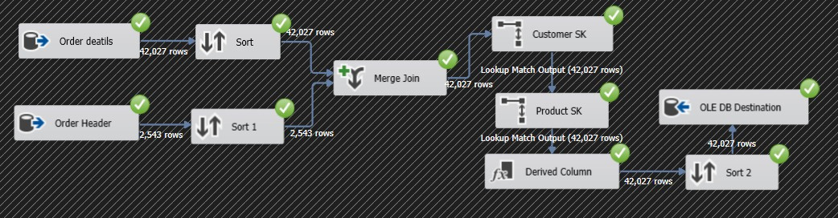
FACTSALES

Slide 10

DATA
MODELING

Slide 11
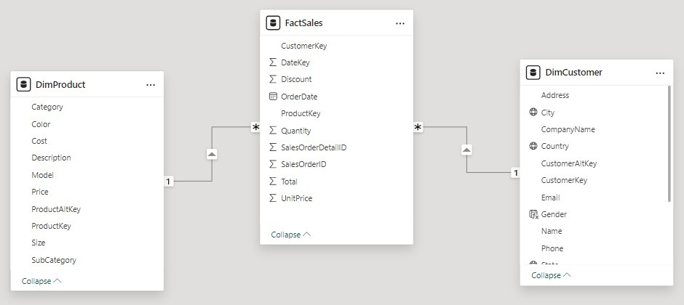
DATA MODEL IN POWER BI

Slide 12
DATA
ANALYSIS

Slide 13
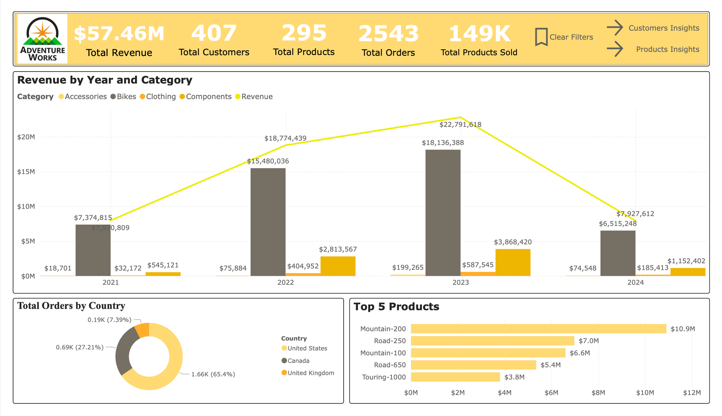

Slide 14
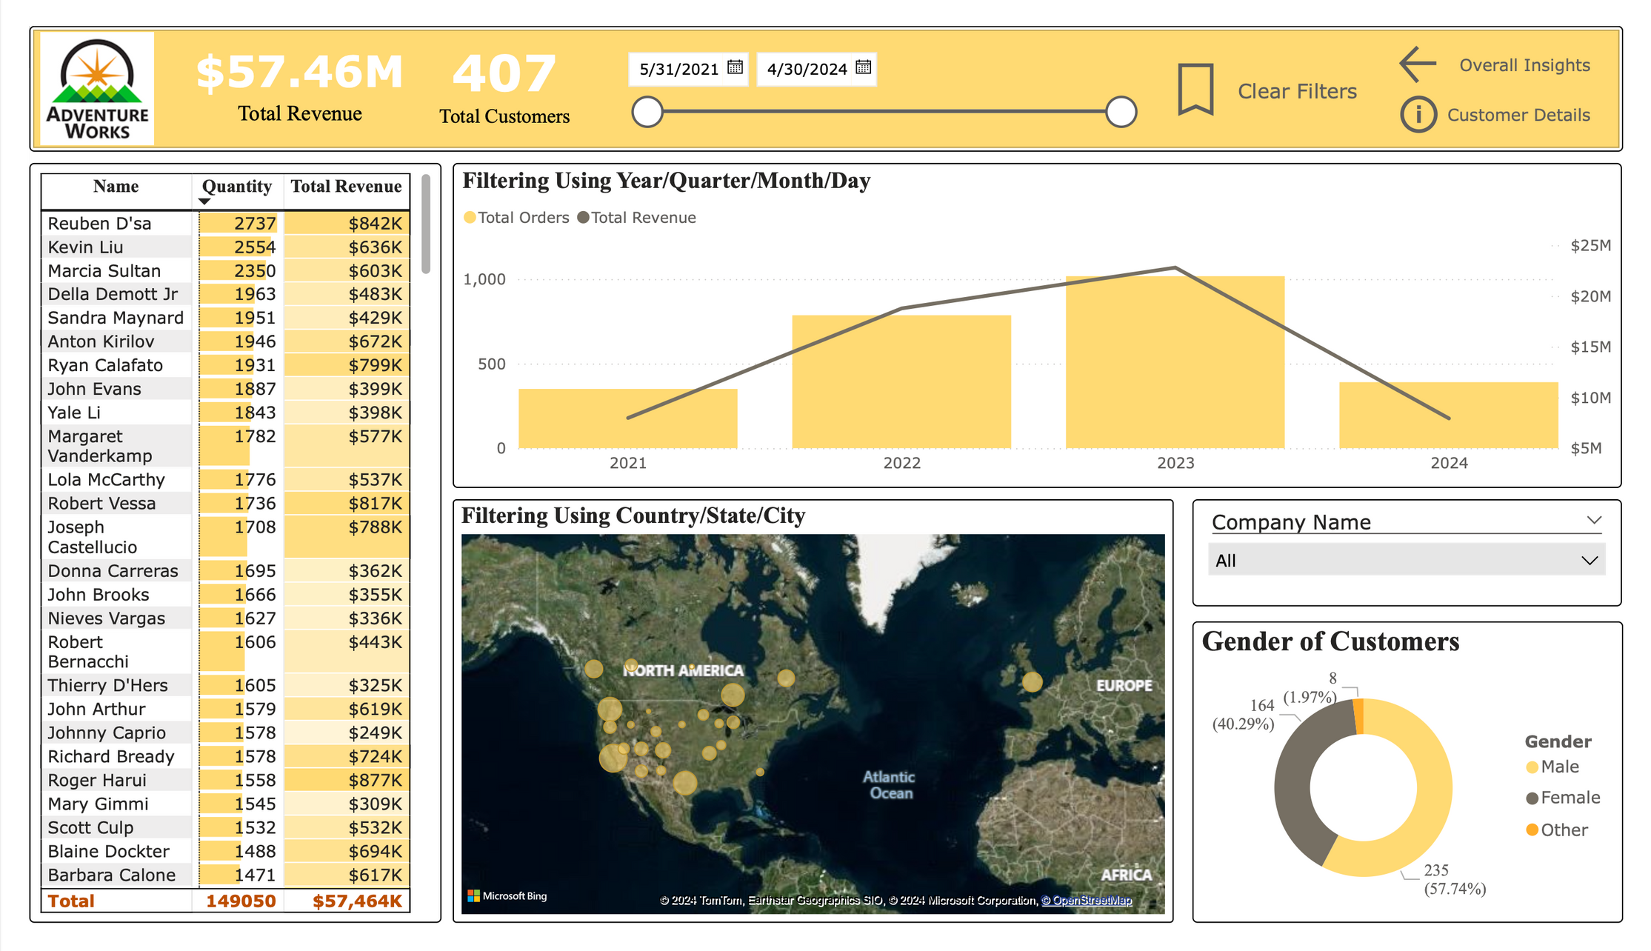

Slide 15
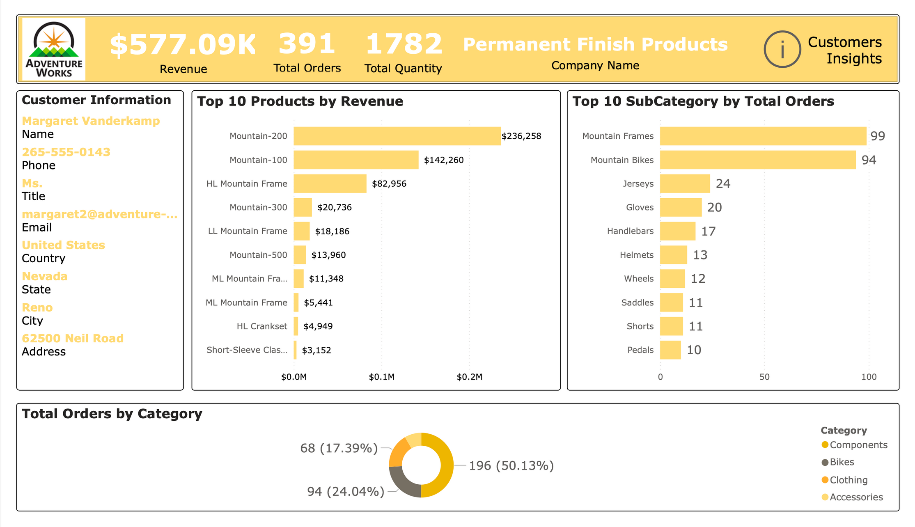

Slide 16
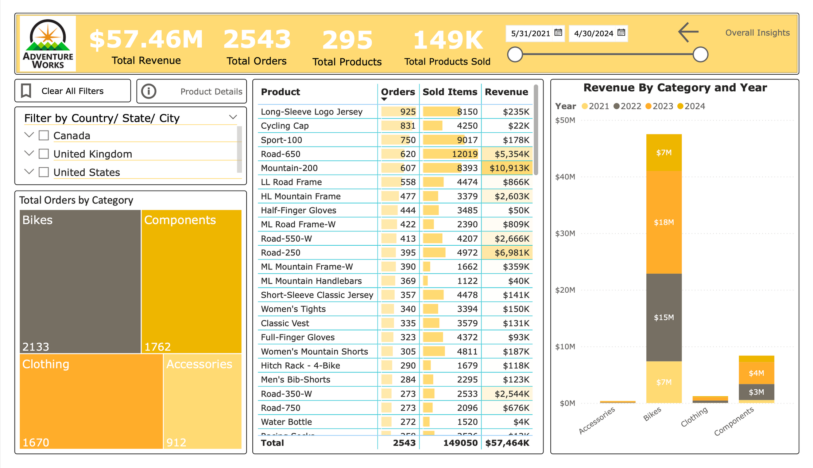

Slide 17
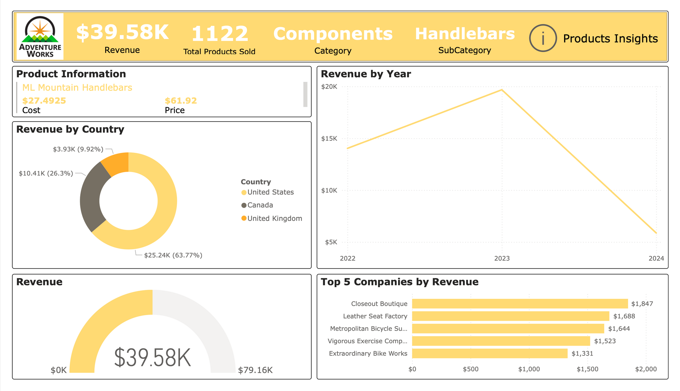

Slide 18
CONCLUSIONS
Over the past four years, our company has achieved a total revenue of 57.46 million USD. The year 2023 stood out as our most successful year. The United States emerged as our leading market in terms of sales volume. Notably, the Mountain-200 product category showed the highest demand, underscoring its popularity among our customer base.

Slide 19

THANK
YOU!

